Slide 1

Fake News

Slide 2
Welcome
Project Real is a programme which has been designed by young people, influencers, teachers and university academics.
It aims to help you to recognise fake news including fake news, photos, videos and conspiracy theories.

Slide 3
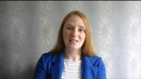
Welcome video- Dr Yvonne Skipper
Notes:
https://www.youtube.com/watch?v=tjRWtL4FSyo

Slide 4
Aims for this session
To understand what fake news is
To understand and know how to use the SHARE checklist

Slide 5
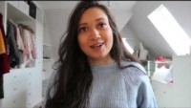
Meet the team!
Notes:
https://www.youtube.com/watch?v=SnZmcv31W80

Slide 6
Starter - Discussion
Have you ever come across fake news?
Can you give an example?
Why should we worry about fake news?

Slide 7
Starter - Activity
In pairs or small groups write down as many answers to the following question:
How can you tell if news is real or fake?

Slide 8
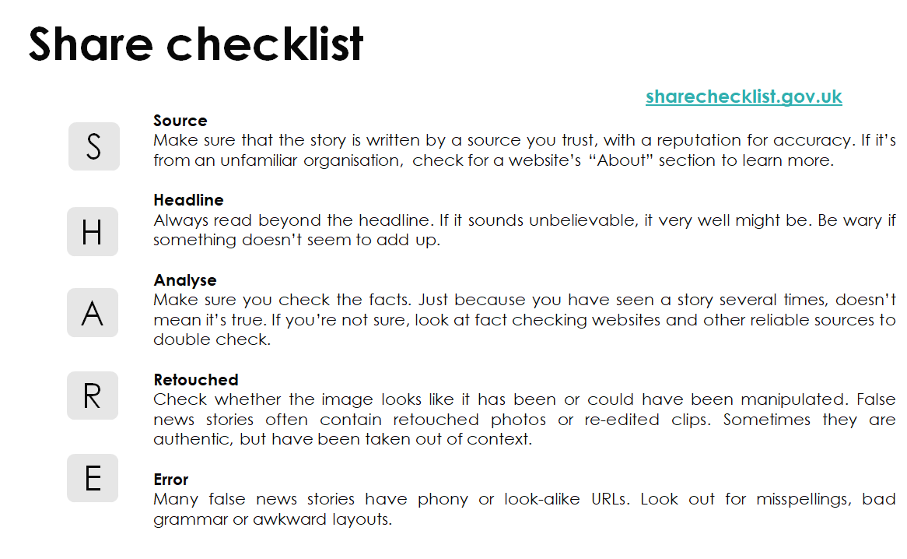
This is how the UK Government recommends you spot fake news...

Slide 9
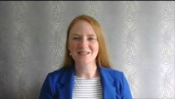
How to use the SHARE checklist - Dr Yvonne Skipper
Notes:
https://www.youtube.com/watch?v=SvRD4yUt3qg

Slide 10

Main Activity
You will now be shown some news headlines.
In your groups use the SHARE checklist to work out which ones are true and which ones are fake.
Also, think about why that’s your answer!
Notes:
Students can work in groups to discuss this. Or if you prefer, you can designate one corner of the room for ‘true’ and another corner for ‘false’ and students can move to the corner (or somewhere along an imaginary line from True to False) to give their answer.
Regardless of the method you use to ask students to give their answers, please encourage them to discuss their ideas and link back to the SHARE checklist.

Slide 11
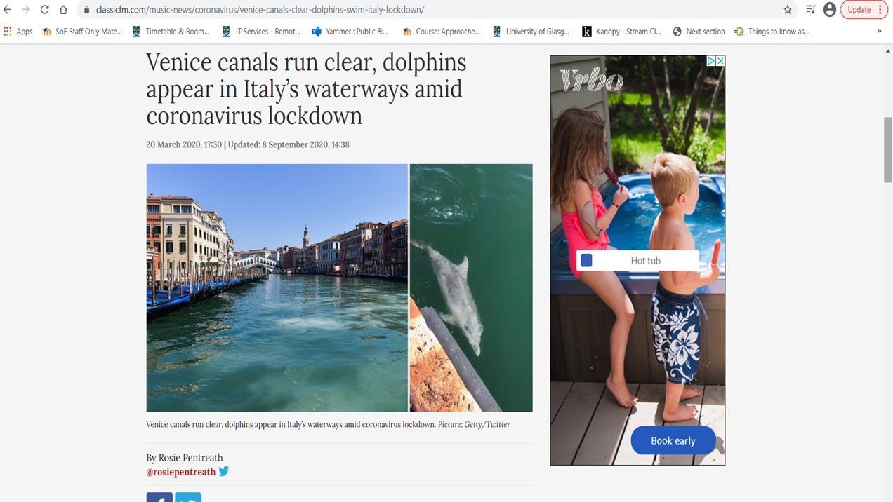
Dolphins in Venice
Notes:
Fake. Dolphins are sometimes found in certain areas of Venice. The photo was taken in an area of Venice where dolphins are regularly spotted.
https://www.classicfm.com/music-news/coronavirus/venice-canals-clear-dolphins-swim-italy-lockdown/
Classic fm might not be a trustworthy source so this is an example of Source from SHARE guidelines
It may also be worth reading beyond the headline to learn more details. This is an example of Headlines from the SHARE guidelines

Slide 12
Questions
Is this real or fake news?
How do you know?
What did you look for to know if it was real or fake? (SHARE guidelines)

Slide 13
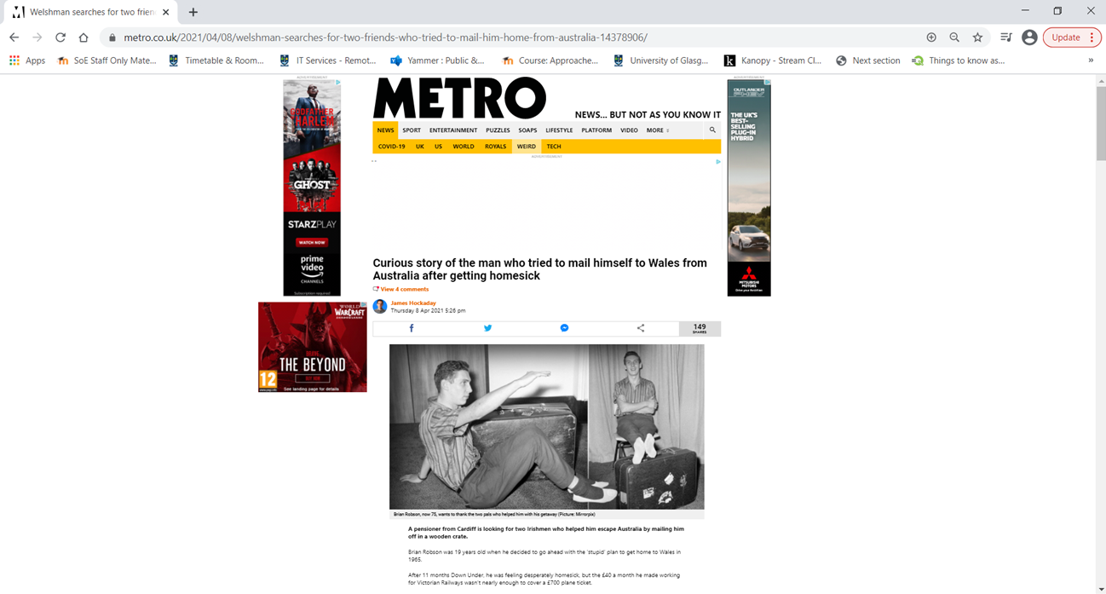
Notes:
This is True!
Metro is an established paper. You can fact check this story for Accuracy which is one of the SHARE guidelines
https://metro.co.uk/2021/04/08/welshman-searches-for-two-friends-who-tried-to-mail-him-home-from-australia-14378906/

Slide 14
Questions
Is this real or fake news?
How do you know?
What did you look for to know if it was real or fake? (SHARE guidelines)

Slide 15
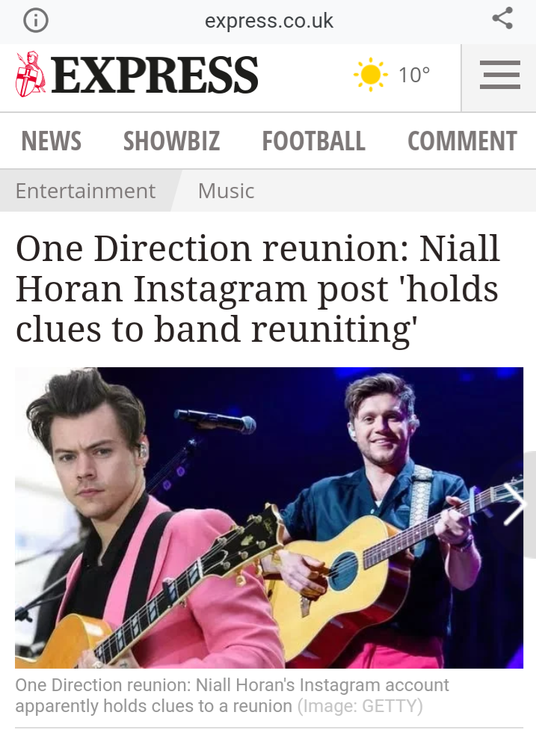
Notes:
The Express believe it is true, but you would need to read beyond the headline to see what you think
This might be an example of Headline from the SHARE guidelines

Slide 16
Questions
Is this real or fake news?
How do you know?
What did you look for to know if it was real or fake? (SHARE guidelines)

Slide 17
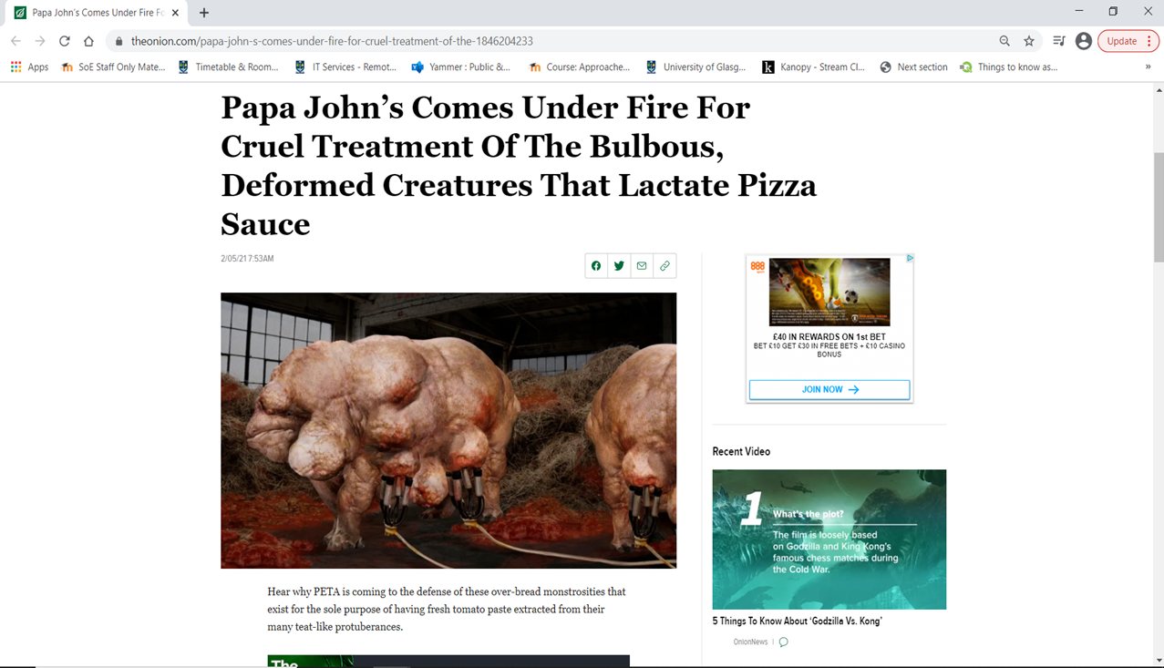
Notes:
https://www.theonion.com/papa-john-s-comes-under-fire-for-cruel-treatment-of-the-1846204233
The Onion is a well known ‘spoof website’ This is Fake news. The photo has been photoshopped.
This is an example of Source, Retouched and Accuracy (there are no creatures like this!) in the SHARE guidelines

Slide 18
Questions
Is this real or fake news?
How do you know?
What did you look for to know if it was real or fake? (SHARE guidelines)

Slide 19
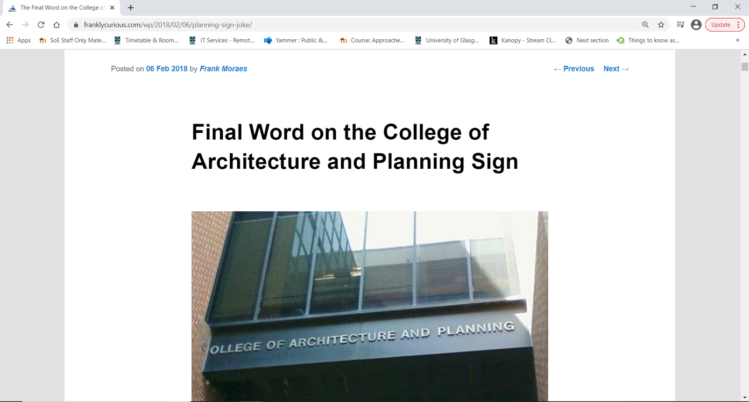
Notes:
https://franklycurious.com/wp/2018/02/06/planning-sign-joke/
This was photoshopped (very well!)
You may be able to tell from the URL. This is an example of Source from the SHARE guidelines

Slide 20
Questions
Is this real or fake news?
How do you know?
What did you look for to know if it was real or fake? (SHARE guidelines)

Slide 21
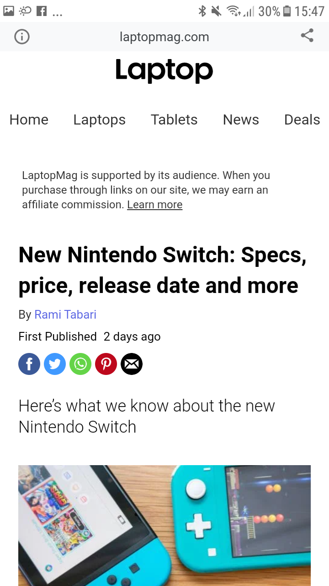
Notes:
This is fake, the reliability of the source can be questioned as it's not from Nintendo official etc (an example of Source from the SHARE checklist), the pictures are simply of the most recent Nintendo Switch and if you look elsewhere on other websites it is clear it is just a rumour (an example of Analyse from the SHARE Checklist).

Slide 22
Questions
Is this real or fake news?
How do you know?
What did you look for to know if it was real or fake? (SHARE guidelines)

Slide 23
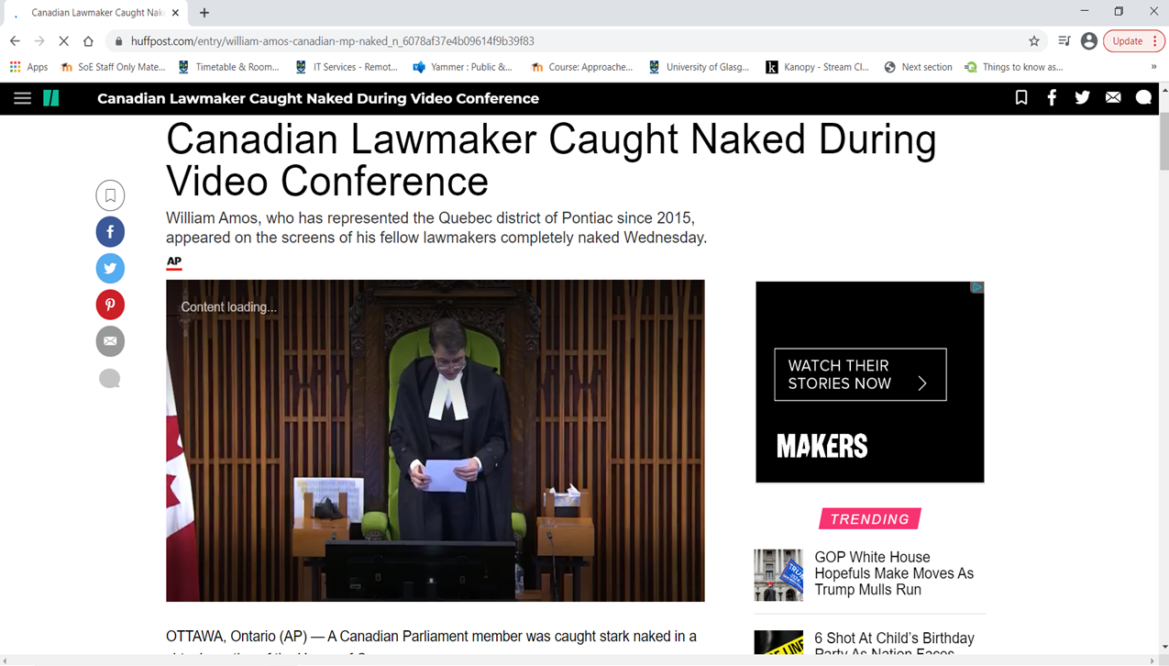
Notes:
This one is apparently true
He accidentally turned his camera on when he was getting changed after having been for a jog
You can fact check this for Accuracy under the SHARE guidelines
https://www.huffpost.com/entry/william-amos-canadian-mp-naked_n_6078af37e4b09614f9b39f83

Slide 24
Questions
Is this real or fake news?
How do you know?
What did you look for to know if it was real or fake? (SHARE guidelines)

Slide 25

Notes:
This was a fake Facebook post. Her T shirt did not say this, it actually said ‘stop being desperate’.
It has been photoshpped. You might be able to tell as the last word on her t shirt does not seem to follow the lines of her body as much as the other words. But it is a very good photoshop. This is an example of Retouching in the SHARE guidelines

Slide 26
Questions
Is this real or fake news?
How do you know?
What did you look for to know if it was real or fake? (SHARE guidelines)

Slide 27
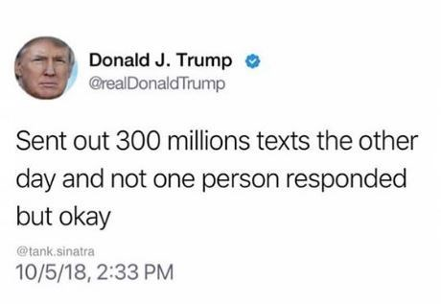
Notes:
This is fake
There are numerous websites you an use to create Tweets that look real
There are also spelling mistakes in the Tweet. And the user name is not correct. This is an example of Errors in the SHARE guidelines

Slide 28
Questions
Is this real or fake news?
How do you know?
What did you look for to know if it was real or fake? (SHARE guidelines)

Slide 29
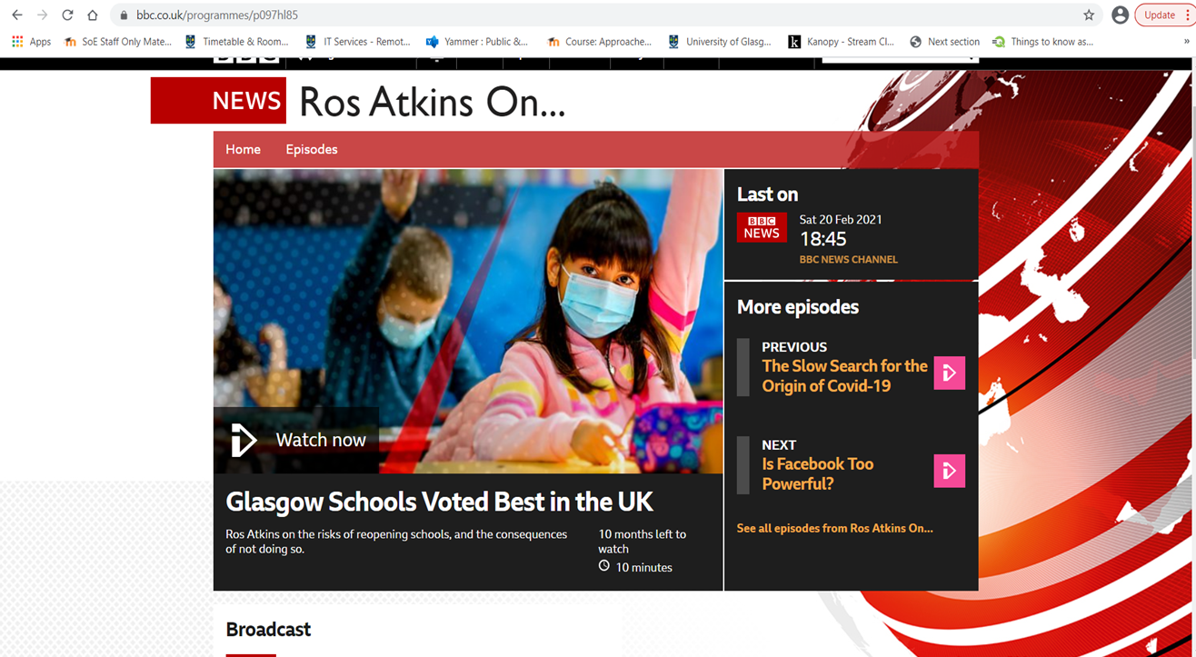
Notes:
This is not real
The article is on the BBC website, but I manipulated the headline. The headline is actually about Covid-19.
This may be an example of accuracy from the SHARE guidelines. You could check it elsewhere.

Slide 30
Questions
Is this real or fake news?
How do you know?
What did you look for to know if it was real or fake? (SHARE guidelines)

Slide 31
Closing Activity
Did you find the activity easy or hard?​​
Did you expect it to be easier to spot fake news?​​
Why should we care if people believe fake news?
Notes:
We recommend running this as a class or small group discussions that can be fed back to the class.

Slide 32
Summary
Today you have learned:
What fake news is
What the SHARE Checklist is & how to use it

Slide 33
Links to our learning
The SHARE checklist can be useful in all your lessons
For example, when you are researching information to include in your homework you could use the SHARE guidelines to see if it is trustworthy
Historians use a version of this when verifying their sources

Slide 34
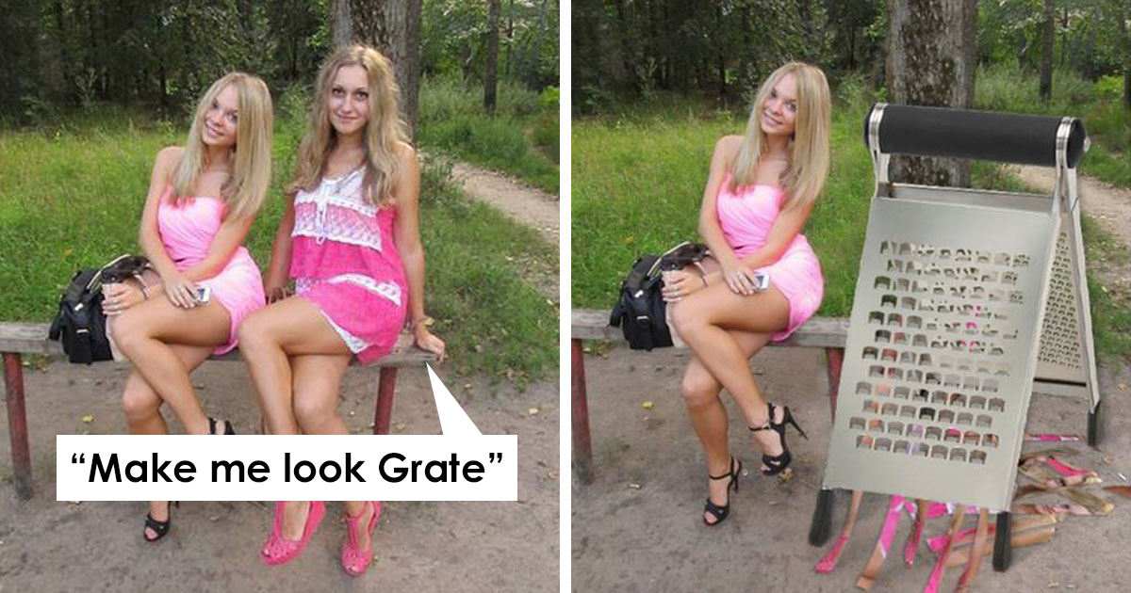
Next week…
FAKE PHOTOS

